Slide 1


Noida Institute of Engineering and Technology, Gr. Noida
Theory of Automata and Formal Languages
(ACSE0404)
Unit: V
Turing Machine
B Tech IT 4th Sem
Ankur Kumar Varshney
Assistant Professor
(IT Department)

Slide 2
Index
Course Outcomes
Syllabus
Contents of the Unit
Objectives of the Unit
CO- PO correlation w.r.t. Unit
CO-PSO correlation w.r.t. Unit
Prerequisite for the course
Objectives of the topic
Topic mapping with CO
Video Links
Daily Quiz
MCQs
Weekly assignment
Old University Exam Paper
Expected Questions for University Exams
Summary
References

Slide 3

Result Analysis
Subject Result:
Department Result:
Faculty-Wise Result:

Slide 4
End Semester Question Paper Template
B.TECH
(SEM-IV) THEORY EXAMINATION 20__-20__
THEORY OF AUTOMATA & FORMAL LANGUAGES
Time: 3 Hours Total Marks: 100
Note: 1. Attempt all Sections. If require any missing data; then choose suitably.
SECTION A
Attempt all questions in brief. 2 x 10 = 20
Q.No. | Question | Marks | CO
1 |  | 2
2 |  | 2
. |  | .
10 |  | 2
Ankur Kumar Varshney ACSE0404 (TAFL) Unit V

Slide 5
End Semester Question Paper Templates
SECTION B
2. Attempt any three of the following: 3 x 10 = 30
SECTION C
3. Attempt any one part of the following: 1 x 10 = 10
Q.No. | Question | Marks | CO
1 |  | 10
2 |  | 10
. |  | .
5 |  | 10
Q.No. | Question | Marks | CO
1 |  | 10
2 |  | 10

Slide 6
End Semester Question Paper Templates
4. Attempt any one part of the following: 1 x 10 = 10
5. Attempt any one part of the following: 1 x 10 = 10
6. Attempt any one part of the following: 1 x 10 = 10
Q.No. | Question | Marks | CO
1 |  | 10
2 |  | 10
Q.No. | Question | Marks | CO
1 |  | 10
2 |  | 10
Q.No. | Question | Marks | CO
1 |  | 10
2 |  | 10
Ankur Kumar Varshney ACSE0404 (TAFL) Unit V

Slide 7
End Semester Question Paper Templates
7. Attempt any one part of the following: 1 x 10 = 10
Q.No. | Question | Marks | CO
1 |  | 10
2 |  | 10
Ankur Kumar Varshney ACSE0404 (TAFL) Unit V

Slide 8
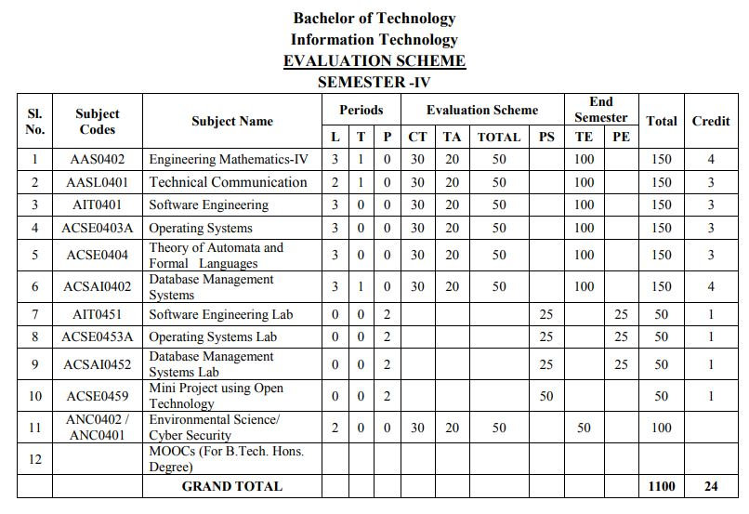
Evaluation Scheme

Slide 9

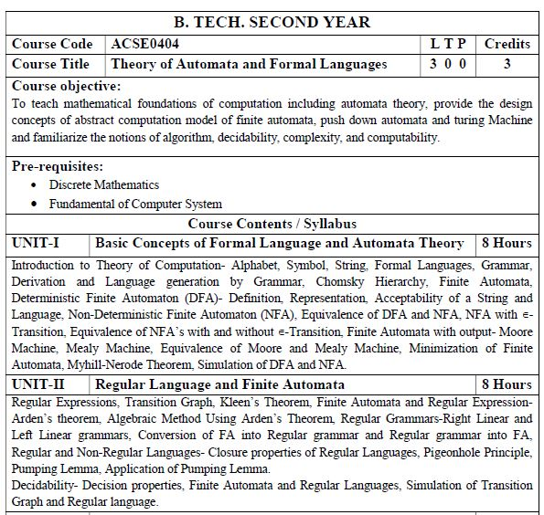
Subject Syllabus

Slide 10
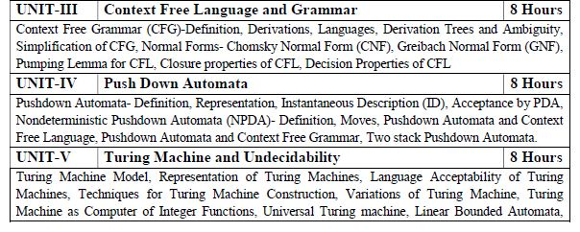

Subject Syllabus

Slide 11
Links
LINKS
https://nptel.ac.in/courses/111103016

Slide 12
Branch Wise Applications
It can compute man-made problems as well as natural phenomena.
Automata theory has a lot of applications in real life as well, such that: Lambda calculus, Combinatory logic, Markov algorithm, and Register, Natural Language Processing ,Compiler Design and Lexical analysis and Semantic analysis. Also, the concept of Formal languages and automata theory can overlap with other subjects as well.

Slide 13
Course Objective
Introduce concepts in automata theory and theory of computation
Identify different formal language classes and their relationships and PDAs.
Applying the Concept of Turing Machine and LBAs.
Prove or disprove theorems in automata theory using its properties
Determine the decidability and intractability of computational problems and complexity theory.

Slide 14
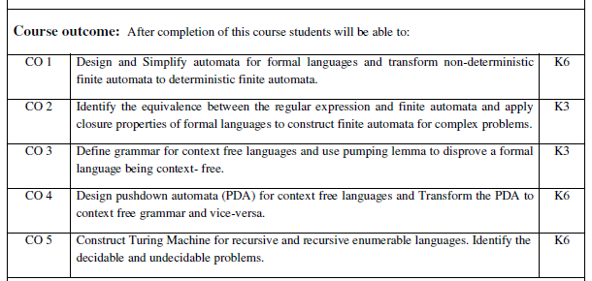
Course Outcome

Slide 15
Program Outcomes (POs)
Engineering Graduates will be able to:
1. Engineering knowledge: Apply the knowledge of mathematics, science, engineering fundamentals, and an engineering specialization to the solution of complex engineering problems.
2. Problem analysis: Identify, formulate, review research literature, and analyze complex engineering problems reaching substantiated conclusions using first principles of mathematics, natural sciences, and engineering sciences.
3. Design/development of solutions: Design solutions for complex engineering problems and design system components or processes that meet the specified needs with appropriate consideration for the public health and safety, and the cultural, societal, and environmental considerations.
4. Conduct investigations of complex problems: Use research-based knowledge and research methods including design of experiments, analysis and interpretation of data, and synthesis of the information to provide valid conclusions.

Slide 16
Program Outcomes (POs)
Contd..
5. Modern tool usage: Create, select, and apply appropriate techniques, resources, and modern engineering and IT tools including prediction and modeling to complex engineering activities with an understanding of the limitations.
6. The engineer and society: Apply reasoning informed by the contextual knowledge to assess societal, health, safety, legal and cultural issues and the consequent responsibilities relevant to the professional engineering practice.
7. Environment and sustainability: Understand the impact of the professional engineering solutions in societal and environmental contexts, and demonstrate the knowledge of, and need for sustainable development.
8. Ethics: Apply ethical principles and commit to professional ethics and responsibilities and norms of the engineering practice.

Slide 17
Program Outcomes (POs)
Contd..
9. Individual and team work: Function effectively as an individual, and as a member or leader in diverse teams, and in multidisciplinary settings.
10. Communication: Communicate effectively on complex engineering activities with the engineering community and with society at large, such as, being able to comprehend and write effective reports and design documentation, make effective presentations, and give and receive clear instructions.
11. Project management and finance: Demonstrate knowledge and understanding of the engineering and management principles and apply these to one’s own work, as a member and leader in a team, to manage projects and in multidisciplinary environments.
12. Life-long learning: Recognize the need for, and have the preparation and ability to engage in independent and life-long learning in the broadest context of technological change.

Slide 18
CO-PO Correlation Matrix
 | PO1 | PO2 | PO3 | PO4 | PO5 | PO6 | PO7 | PO8 | PO9 | PO10 | PO11 | PO12
CO1 | 2 | 2 | 3 | 3 | 2 | 2 | - | - | 2 | 1 | - | 3
CO2 | 1 | 3 | 2 | 3 | 2 | 2 | - | 1 | 1 | 1 | 2 | 2
CO3 | 2 | 2 | 3 | 2 | 2 | 2 | - | 2 | 2 | 1 | 2 | 3
CO4 | 2 | 2 | 2 | 3 | 2 | 2 | - | 2 | 2 | 1 | 1 | 3
CO5 | 3 | 2 | 2 | 2 | 2 | 2 | - | 2 | 1 | 1 | 1 | 2
Average | 2 | 2.2 | 2.4 | 2.6 | 2 | 2 | - | 1.4 | 1.6 | 1 | 1.2 | 2.6

Slide 19
CO-PSO Correlation Matrix
CO | PSO
 | PSO1 | PSO2 | PSO3 | PSO4
CO1 | 2 | 2 | 2 | 2
CO2 | 2 | 2 | 1 | 1
CO3 | 2 | 2 | 1 | 1
CO4 | 2 | 2 | 1 | 1
CO5 | 2 | 2 | 2 | 2
Average | 2 | 2 | 1.4 | 1.4

Slide 20
Program Educational Objectives
PEO1: To have an excellent scientific and engineering breadth so as to comprehend, analyze, design and provide sustainable solutions for real-life problems using state-of-the-art technologies.
PEO2: To have a successful career in industries, to pursue higher studies or to support entrepreneurial endeavors and to face global challenges.
PEO3: To have an effective communication skills, professional attitude, ethical values and a desire to learn specific knowledge in emerging trends, technologies for research, innovation and product development and contribution to society.
PEO4: To have life-long learning for up-skilling and re-skilling for successful professional career as engineer, scientist, entrepreneur and bureaucrat for betterment of society

Slide 21
CO-PEO Mapping
CO-PEO Correlation Matrix
Sr. No | Course Outcome | PEO1 | PEO2 | PEO3 | PEO4
1 | CO 1 | 1 | 2 | 2 | 2
2 | CO 2 | 2 | 1 | 3 | 1
3 | CO 3 | 2 | 3 | 1 | 2
4 | CO 4 | 3 | 2 | 1 | 3
5 | CO 5 | 1 | 2 | 2 | 1

Slide 22
Syllabus
UNIT-5
Turing Machine Model, Representation of Turing Machines, Language Acceptability of Turing Machines, Techniques for Turing Machine Construction, Variations of Turing Machine, Turing Machine as Computer of Integer Functions, Universal Turing machine, Linear Bounded Automata, Church’s Thesis, Recursive and Recursively Enumerable language, Closure Properties of Recursive and Recursively Enumerable Languages, Non-Recursively Enumerable and Non-Recursive Languages, Undecidability, Halting Problem, Undecidability of Halting Problem, Post’s Correspondence Problem.

Slide 23
UNIT-5
Topics | Duration (in Hours)
TURING MACHINE | 2
Techniques for Turing Machine Construction | 3
Universal Turing machine, Linear Bounded Automata, | 1
Church’s Thesis, Recursive and Recursively Enumerable language, | 1
Halting Problem, Post’s Correspondance Problem, Introduction to Recursive Function Theory. | 2

Slide 24
Objective of Unit
Topic Objective: To understand the formal definition of Turing Machine.
Mathematical representation of Turing Machine
IDs of Turing Machine
Recap: In previous unit we have studied about Push Down Automata.
Prerequisite: Basic review of model to perform different operations like addition, subtraction, multiplication.

Slide 25
CO-PO correlation matrix
CO-PO correlation matrix w.r.t. Unit-5
CO4 | 2 | 2 | 2 | 3 | 2 | 2 | - | 2 | 2 | 1 | 1 | 3
CO5 | 3 | 2 | 2 | 2 | 2 | 2 | - | 2 | 1 | 1 | 1 | 2

Slide 26
CO-PSO correlation matrix
CO-PSO correlation matrix w.r.t. Unit-5
CO5 | 2 | 2 | 2 | 2

Slide 27
Prerequisite and Recap
Prerequisite: Basic review of model to perform different operations like addition, subtraction, multiplication.
Recap: In previous unit we have studied about Push Down Automata.

Slide 28
Turing Machine(CO5)
Objective of the Topic
The objective of the topic is to make the student able to:
To understand the formal definition of Turing Machine.
Mathematical representation of Turing Machine
IDs of Turing Machine

Slide 29
Turing Machine(CO5)
Topic mapping with Course Outcome
Topic | CO1 | CO2 | CO3 | CO4 | CO5
Turing Machine | - |  | - | - | 3

Slide 30
Unit-5 Syllabus
Turing Machine Model, Representation of Turing Machines, Language Acceptability of Turing Machines, Techniques for Turing Machine Construction, Variations of Turing Machine, Turing Machine as Computer of Integer Functions, Universal Turing machine, Linear Bounded Automata, Church’s Thesis, Recursive and Recursively Enumerable language, Closure Properties of Recursive and Recursively Enumerable Languages, Non-Recursively Enumerable and Non-Recursive Languages, Undecidability, Halting Problem, Undecidability of Halting Problem, Post’s Correspondence Problem.

Slide 31
Introduction (CO5)
Topic Objective: To understand the formal definition of Turing Machine.
Mathematical representation of Turing Machine
IDs of Turing Machine
Recap: In previous unit we have studied about Push Down Automata.
Prerequisite: Basic review of model to perform different operations like addition, subtraction, multiplication.

Slide 32
Introduction (CO5)
Objective: To understand the formal definition of Turing Machine.
Turing machine was invented in 1936 by Alan Turing. It is an accepting device which accepts Recursive Enumerable Language generated by type 0 grammar.
There are various features of the Turing machine:
It has an external memory which remembers arbitrary long sequence of input.
It has unlimited memory capability.
The model has a facility by which the input at left or right on the tape can be read easily.

Slide 33
Introduction (CO5)
Generalize the class of CFLs:
Non-Recursively Enumerable Languages
Recursively Enumerable Languages
Recursive Languages
Context-Free Languages
Regular Languages

Slide 34
Formal definition of Turing machine(CO5)
A Turing machine can be defined as a collection of 7 components:
Q: the finite set of states ∑: the finite set of input symbols T: the tape symbol q0: the initial state F: a set of final states B: a blank symbol used as a end marker for input δ: a transition or mapping function.
(q0, a) → (q1, X, R)
That means in q0 state, if we read symbol 'a' then it will go to state q1, replaced a by X and move ahead right(R stands for right).

Slide 35
TM Example(CO5)
Construct TM for the language L ={0^{n}1^{n}} where n>=1.
We have already solved this problem by PDA. In PDA, we have a stack to remember the previous symbol. The main advantage of the Turing machine is we have a tape head which can be moved forward or backward, and the input tape can be scanned.
The simple logic which we will apply is read out each '0' mark it by A and then move ahead along with the input tape and find out 1 convert it to B. Now, repeat this process for all a's and b's.
Now we will see how this Turing machine work for 0011.

Slide 36


TM Example(CO5)
The simulation for 0011 can be shown as below:
Now, we will see how this turing machine will works for 0011. Initially, state is q0 and head points to 0 as:

Slide 37


TM Example(CO5)
The move will be δ(q0, 0) = δ(q1, A, R) which means it will go to state q1, replaced 0 by A and head will move to the right as:
The move will be δ(q1, 0) = δ(q1, 0, R) which means it will not change any symbol, remain in the same state and move to the right as:

Slide 38


TM Example(CO5)
The move will be δ(q1, 1) = δ(q2, B, L) which means it will go to state q2, replaced 1 by B and head will move to left as:
Now move will be δ(q2, 0) = δ(q2, 0, L) which means it will not change any symbol, remain in the same state and move to left as:

Slide 39


TM Example(CO5)
The move will be δ(q2, A) = δ(q0, A, R), it means will go to state q0, replaced A by A and head will move to the right as:
The move will be δ(q0, 0) = δ(q1, A, R) which means it will go to state q1, replaced 0 by A, and head will move to right as:

Slide 40


TM Example(CO5)
The move will be δ(q1, B) = δ(q1, B, R) which means it will not change any symbol, remain in the same state and move to right as:
The move will be δ(q1, 1) = δ(q2, B, L) which means it will go to state q2, replaced 1 by B and head will move to left as:

Slide 41


TM Example(CO5)
The move δ(q2, B) = (q2, B, L) which means it will not change any symbol, remain in the same state and move to left as:
Now immediately before B is A that means all the 0?s are market by A. So we will move right to ensure that no 1 is present. The move will be δ(q2, A) = (q0, A, R) which means it will go to state q0, will not change any symbol, and move to right as:

Slide 42


TM Example(CO5)
The move δ(q0, B) = (q3, B, R) which means it will go to state q3, will not change any symbol, and move to right as:
The move δ(q3, B) = (q3, B, R) which means it will not change any symbol, remain in the same state and move to right as:

Slide 43
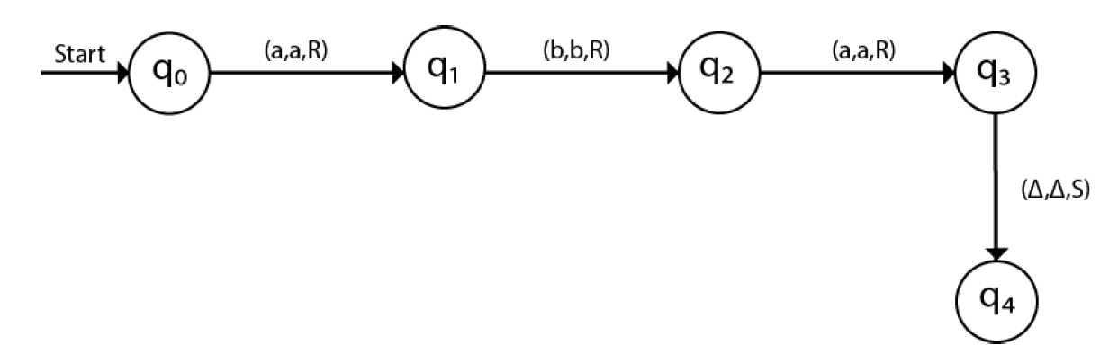
TM Example(CO5)
The move δ(q3, Δ) = (q4, Δ, R) which means it will go to state q4 which is the HALT state and HALT state is always an accept state for any TM.
The same TM can be represented by Transition Diagram:

Slide 44
TM Example(CO5)
Example #1: {w | w is in {0,1}* and w ends with a 0}
0, 00, 10, 10110
Notε
Q = {q₀, q₁, q₂}
Γ = {0, 1, B}
Σ = {0, 1}
F = {q₂}
δ:
0 1 B
->q₀ (q₀, 0, R) (q₀, 1, R) (q₁, B, L)
q₁ (q₂, 0, R) - -
q₂* - - -
q₀ is the start state and the “scan right” state, until hits B
q₁ is the verify 0 state
q₂ is the final state

Slide 45
TM Example(CO5)
Example #2: {0^{n}1^{n} | n ≥ 1}
0 1 X Y B
->q₀ (q₁, X, R) - - (q₃, Y, R)0’s finished -
q₁ (q₁, 0, R)ignore1 (q₂, Y, L) - (q₁, Y, R) ignore2 - (more 0’s)
q₂ (q₂, 0, L) ignore2 - (q₀, X, R) (q₂, Y, L) ignore1 -
q₃ - - (more 1’s) - (q₃, Y, R) ignore (q₄, B, R)
q₄* - - - - -
Sample Computation: (on 0011), presume state q looks rightward
q₀0011BB.. |— Xq₁011
|— X0q₁11
|— Xq₂0Y1
|— q₂X0Y1
|— Xq₀0Y1
|— XXq₁Y1
|— XXYq₁1
|— XXq₂YY
|— Xq₂XYY
|— XXq₀YY
|— XXYq₃Y B…
|— XXYYq₃ BB…
|— XXYYBq₄

Slide 46
Recap
Definition of Turing Machine.
Representation of Turing Machine
Acceptability and ID’s of Turing Machine.

Slide 47
Daily Quiz
Q1: Definition of Turing Machine.
Q2: How we can represent of Turing Machine
Q3: what is ID’s of Turing Machine.

Slide 48
Techniques of Turing Machine Construction(CO5)
Objective of the Topic
The objective of the topic is to make the student able to:
How to design Turing machine for different mathematical models.

Slide 49
Prerequisite and Recap
Prerequisite: Representation of Turing Machine.
Recap: In previous lecture we have studied about representation and working of turing machine.

Slide 50
Construction of Turing Machine(CO5)
Topic mapping with Course Outcome
Topic | CO1 | CO2 | CO3 | CO4 | CO5
Construction of Turing machine | - |  | - | - | 2

Slide 51
Construction of Turing Machine(CO5)
Making a TM for {0^{n}1^{n} | n >= 1}
Try n=2 or 3 first.
q0 is on 0, replaces with the character to X, changes state to q1, moves right
q1 sees next 0, ignores (both 0’s and X’s) and keeps moving right
q1 hits a 1, replaces it with Y, state to q2, moves left
q2 sees a Y or 0, ignores, continues left
when q2 sees X, moves right, returns to q0 for looping step 1 through 5
when finished, q0 sees Y (no more 0’s), changes to pre-final state q3
q3 scans over all Y’s to ensure there is no extra 1 at the end (to crash on seeing any 0 or 1)
when q3 sees B, all 0’s matched 1’s, done, changes to final state q4
blank line for final state q4
Try n=1 next.
Make sure unbalanced 0’s and 1’s, or mixture of 0-1’s,“ crashes” in a state not q4, as it should be

Slide 52
Construction of Turing Machine(CO5)
q₀0011BB.. |— Xq₁011
|— X0q₁11
|— Xq₂0Y1
|— q₂X0Y1
|— Xq₀0Y1
|— XXq₁Y1
|— XXYq₁1
|— XXq₂YY
|— Xq₂XYY
|— XXq₀YY
|— XXYq₃Y B…
|— XXYYq₃ BB…
|— XXYYBq₄

Slide 53
Construction of Turing Machine(CO5)
Same Example #2: {0^{n}1^{n} | n ≥ 1}
0 1 X Y B
q₀ (q₁, X, R) - - (q₃, Y, R) -
q₁ (q₁, 0, R) (q₂, Y, L) - (q₁, Y, R) -
q₂ (q₂, 0, L) - (q₀, X, R) (q₂, Y, L) -
q₃ - - - (q₃, Y, R) (q₄, B, R)
q₄ - - - - -
Logic: cross 0’s with X’s, scan right to look for corresponding 1, on finding it cross it with Y, and scan left to find next leftmost 0, keep iterating until no more 0’s, then scan right looking for B.

Slide 54
Construction of Turing Machine(CO5)
The TM matches up 0’s and 1’s
q₁ is the “scan right” state, looking for 1
q₂ is the “scan left” state, looking for X
q₃ is “scan right”, looking for B
q₄ is the final state
Can you extend the machine to include n=0? How does the input-tape look like for string epsilon?
Other Examples:
000111 00
11 001
011

Slide 55
Construction of Turing Machine(CO5)
Roger Ballard’s TM for Example #2, without any extra Tape Symbol: {0^{n}1^{n} | n ≥ 0}
0 1 B
q₀ (q₁, B, R) (q₄, B, R)
q₁ (q₁, 0, R) (q₁, 1, R) (q₂, B, L)
q₂ - (q₃, B, L) -
q₃ (q₃, 0, L) (q₃, 1, L) (q₀, B, R)
q₄* - - -

Slide 56
Construction of Turing Machine(CO5)
Logic: cross 0’s with X’s, scan right to look for corresponding 1, on finding it cross it with Y, and scan left to find next leftmost 0, keep iterating until no more 0’s, then scan right looking for B.
The TM matches up 0’s and 1’s
q₁ is the “scan right” state, looking for 1
q₂ is the “scan left” state, looking for X
q₃ is “scan right”, looking for B
q₄ is the final state
Can you extend the machine to include n=0? How does the input-tape look like for string epsilon?
Other Examples:
000111 00
11 001
011

Slide 57
Construction of Turing Machine(CO5)
And his example of a correct TM for the language that goes on infinite loop outside language: {0^{n}1^{n} | n ≥ 0}
0 1 B
q₀ (q₁, B, R) (q₃, 1, L) (q₄, B, R)
q₁ (q₁, 0, R) (q₁, 1, R) (q₂, B, L)
q₂ - (q₃, B, L) -
q₃ (q₃, 0, L) (q₃, 1, L) (q₀, B, R)
q₄* - - -
Logic: This machine still works correctly for all strings in the language, but
start a string with 1 (not in the language),
and it loops on B1 for ever.

Slide 58
Construction of Turing Machine(CO5)
Exercises: Construct a DTM for each of the following.
{w | w is in {0,1}* and w ends in 00}
{w | w is in {0,1}* and w contains at least two 0’s}
{w | w is in {0,1}* and w contains at least one 0 and one 1}
Just about anything else (simple) you can think of

Slide 59
Construction of Turing Machine(CO5)
{ 0^{2^n} | n ≥ 0}
Stages
Sweep left to right across the tape. Crossing off every other 0
If in stage 1, the tape conatined a single 0, accept
If in stage 1, the tape contained more than a single 0, and the number of 0’s was odd, reject
Return the head to the left-hand end of the tape
Goto stage 1.

Slide 60
What is important
Construction of Turing Machine(CO5)
We seek to convince the student that Turing machines are a powerful tool to describe algorithms
The full set of details is often too complex to describe completely, because the details do not add to our understanding.
But, we could use our high level descriptions to complete the formal description if we desired.

Slide 61
Turing machines with output
Construction of Turing Machine(CO5)
A Turing machine can compute an output by leaving an answer on the tape when it halts.
We must specify the form of the output when the machine halts.

Slide 62
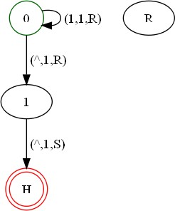
Adding two to a number in unary
Construction of Turing Machine(CO5)
TM | Q | {0, | 1, | H, R}
 | Sigma | {1}
 | Gamma | {1, | ^}
 | Delta | 0 1 | -> | (1, R, | 0)
 |  | 0 ^ | -> | (1, R, | 1)
 |  | 1 ^ | -> | (1, S, | H)
 | q0 | 0
 | Accept | H
 | Reject | R
 | Blank | ^

Slide 63
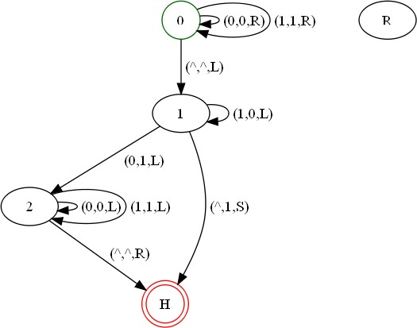
Adding 1 to a Binary Number
Construction of Turing Machine(CO5)
TM Q {0, 1, 2, H, R}
Sigma {1, 0, ^}
Gamma {1, 0, ^}
Delta 0 0 -> (0, R, 0)
0 1 -> (1, R, 0)
0 ^ -> (^, L, 1)
1 0 -> | (1, L, 2)
1 1 -> | (0, L, 1)
1 ^ -> | (1, S, H)
2 0 -> | (0, L, 2)
2 1 -> | (1, L, 2)
2 ^ -> | (^, R, H)
q0 0 Accept H Reject R Blank ^
^1011^
^1010^
^1000^
^1100^

Slide 64
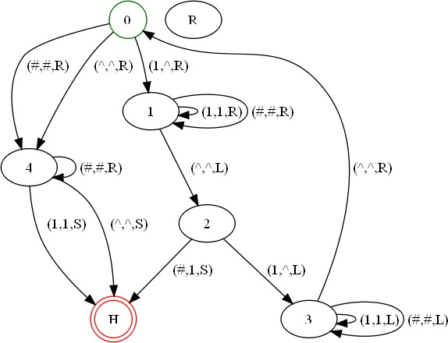
states = 0,1,2,3,4,H tape alphabet = 1,0,#,^ input alphabet = 1,0,#
Construction of Turing Machine(CO5)
An equality Test
start blank final
= 0
= ‘^'
= H
delta = (0,1,^,R,1)
(0,^,^,R,4)
(0,#,#,R,4)
(1,1,1,R,1)
(1,^,^,L,2)
(1,#,#,R,1)
(2,1,^,L,3)
(2,#,1,S,H)
(3,1,1,L,3)
(3,^,^,R,0)
(3,#,#,L,3)
(4,1,1,S,H)
(4,^,^,S,H)
(4,#,#,R,4)

Slide 65
Configurations
Construction of Turing Machine(CO5)
(Sipser pg. 140)
configurations for TM's are strings of the form  q  , where
,   * and q  Q. (Assume that Q and * are disjoint sets, guaranteeing unique parsing of configurations.)
The string  represents the tape contents to the left of the head.
The string  represents the non-blank tape contents to the right of the head, including the currently scanned cell.
Adding or deleting a few blank symbols at the beginning or end of an confiuration results in an equivalent configuartion. Both represent the same instant in the execution of a TM.

Slide 66
Sipser terminology
Construction of Turing Machine(CO5)
Other authors call configurations instantaneous descriptions
Starting Configuration
Accepting Configuration
Rejecting Configuration
Both of these are halting configurations

Slide 67
Relating configurations
Construction of Turing Machine(CO5)
TM's transitions induce the relation |- between configurations.
Let  =X₁. . . X_{i-1} q X_{i} . . . X_{k} be an configuration.
If (q,X_{i}) is undefined, then there are no configurations  ' such that  |-  '.
If (q,X_{i})=(p,Y,R) then
⬥ |-  ' holds for  ' = X₁. . . X_{i-1} Y p X_{i+1}. . . X_{k}
Similarly, if (q,X_i)=(p,Y,L)
then  |- ’ holds for ’ =X₁. . . pX_{i-1}YX_{i+1} . . . X_{k}
When  |- ’ Sipser says: “  yields ’ ”

Slide 68
Note
Construction of Turing Machine(CO5)
If, in the first case, we have i=k, (that is we are at the end of the non-blank portion of the tape to the right) then we need to use the equivalent representation
⬥ = X₁ . . . X_{k-1} q X_{k} B
for our formula to make sense. Similarly, we add a B to the beginning of  whenever necessary.

Slide 69
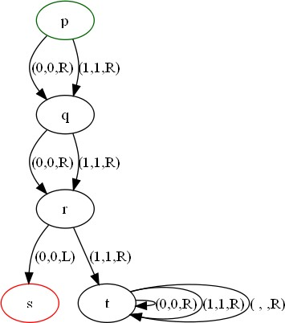
Example
Construction of Turing Machine(CO5)
Here is the sequence of configurations of our example machine, showing its execution with the given input 0101:
p0101 |- 0q101 |-01r01 |- 0s101
The machine halts, since there are no moves from the state s. When the input is 0111, the machine goes forever, as follows:
p0111 |- 0q111 |- 01r11 |- 011t1
|- 0111t |- 0111Bt |- 0111BBt |-

Slide 70
The Language of a TM
Construction of Turing Machine(CO5)
We define the language of the TM M to be the set L(M) of all strings w  *
such that: Q₀ w |-*  q_{accept} 
for any , 
Languages accepted by TM's are call recursively enumerable
(RE). Sipser calls this Turing-recognizable
Example. For our example machine, we have L(M)= (0+1)(0+1)0(0+1)*
If the machine recognizes some language, and also halts for all inputs. We say the language is Turing-decidable.

Slide 71
Acceptance by Halting
Construction of Turing Machine(CO5)
Some text books define an alternative way of defining a language associated with a TM M. (But not Sipser, though the idea is still interesting).
We denote it H(M), and it consists of strings that cause the TM to halt. Precisely, a string w  * belongs to H(M)
iff q₀ w |-*  p X 
where (p,X) is undefined.
Example. For our example machine, we have
H(M)=  + 0 + 1 + (0+1)(0+1) + (0+1)(0+1)0(0+1)*

Slide 72
Construction of Turing Machine(CO5)
Equivalence of Acceptance by Final State and Halting
How would we prove such an equivalence?
1. Construct a TM that accepts by Halting from an ordinary one.
2. Construct an ordinary TM from one that accepts by halting.

Slide 73
Recap
Construction method of Turing Machine.
Numerical of Turing Machine.

Slide 74
Daily Quiz
Q1: Design a Turing machine for 0n1n2n, n>0;
Q2:Desing a Turing machine for f(m,n)=m*n;

Slide 75
Universal Turing Machine (CO5)
Topic Objective: To understand the Universal Turing Machine.
Recap: Till now we have studied about Turing Machine.
Prerequisite: Basic review of model to perform different operations like addition, subtraction, multiplication.

Slide 76
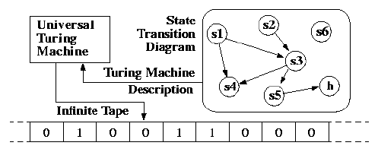
Universal Turing Machine (CO5)
Objective: To understand the Universal Turing Machine.
A Turing Machine is the mathematical tool equivalent to a digital computer.
It was suggested by the mathematician Turing in the 30s, and has been since then the most widely used model of computation in computability and complexity theory.
The model consists of an input output relation that the machine computes.
The input is given in binary form on the machine's tape, and the output consists of the contents of the tape when the machine halts.

Slide 77
Universal Turing Machine (CO5)
What determines how the contents of the tape change is a finite state machine (or FSM, also called a finite automaton) inside the Turing Machine.
The FSM is determined by the number of states it has, and the transitions between them.
At every step, the current state and the character read on the tape determine the next state the FSM will be in, the character that the machine will output on the tape (possibly the one read, leaving the contents unchanged), and which direction the head moves in, left or right.
The problem with Turing Machines is that a different one must be constructed for every new computation to be performed, for every input output relation.
This is why we introduce the notion of a universal turing machine (UTM), which along with the input on the tape, takes in the description of a machine M.
The UTM can go on then to simulate M on the rest of the contents of the input tape. A universal turing machine can thus simulate any other machine.

Slide 78
Linear Bounded Automata (CO5)
Topic Objective: To understand the Linear Bounded Automata.
Recap: Till now we have studied about Turing Machine and Universal Turing Machine.
Prerequisite: Basic review of model to perform different operations like addition, subtraction, multiplication.

Slide 79
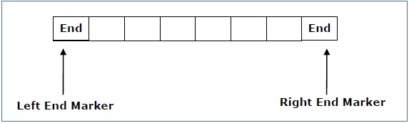
Linear Bounded Automata (CO5)
Objective: To understand the Linear Bounded Automata.
A linear bounded automaton is a multi-track non-deterministic Turing machine with a tape of some bounded finite length.
Length = function (Length of the initial input string, constant c)
Here,
Memory information ≤ c × Input information
Link: https://www.youtube.com/watch?v=kFH4X69L1JU

Slide 80
Linear Bounded Automata(CO5)
A linear bounded automaton can be defined as an 8-tuple (Q, X, ∑, q₀, ML, MR, δ, F) where −
Q is a finite set of states
X is the tape alphabet
∑ is the input alphabet
q₀ is the initial state
M_{L} is the left end marker
M_{R} is the right end marker where M_{R} ≠ M_{L}
δ is a transition function which maps each pair (state, tape symbol) to (state, tape symbol, Constant ‘c’) where c can be 0 or +1 or -1
F is the set of final states

Slide 81
Church’s Thesis (CO5)
Topic Objective: To understand the importance of Church Thesis in Theory of Computation.
Recap: Till now we have studied about Turing Machine, Universal Turing Machine and Linear Bounded Automata.
Prerequisite: Basic review of model to perform different operations like addition, subtraction, multiplication.

Slide 82
Church’s Thesis (CO5)
Objective: To understand the importance of Church Thesis in Theory of Computation.
In 1936, Alonzo Church created a method for defining functions called the λ-calculus. Within λ-calculus, he defined an encoding of the natural numbers called the Church numerals.
Also in 1936, before learning of Church's work, Alan Turing created a theoretical model for machines, now called Turing machines, that could carry out calculations from inputs by manipulating symbols on a tape.
A Turing machine is an abstract representation of a computing device.
It is more like a computer hardware than a computer software.
Link: https://www.youtube.com/watch?v=EEfNU8AoA-8

Slide 83
Church’s Thesis (CO5)
The Church-Turing thesis concerns an effective or mechanical method in logic and mathematics.
A method, M, is called ‘effective’ or ‘mechanical’ just in case:
M is set out in terms of a finite number of exact instructions (each instruction being expressed by means of a finite number of symbols);
M will, if carried out without error, always produce the desired result in a finite number of steps;

Slide 84
Church’s Thesis (CO5)
M can (in practice or in principle) be carried out by a human being unaided by any machinery except for paper and pencil;
M demands no insight or ingenuity on the part of the human being carrying it out.
They gave an hypothesis which means proposing certain facts.
The Church’s hypothesis or Church’s turing thesis can be stated as:
The assumption that the intuitive notion of computable functions can be identified with partial recursive functions.
This statement was first formulated by Alonzo Church in the 1930s and is usually referred to as Church’s thesis, or the Church-Turing thesis.
However, this hypothesis cannot be proved.

Slide 85
Decision Problems(CO5)
Informally, a (decision) “problem” is a yes/no question about an infinite set of possible instances.
Example 1: “Does graph G have a Hamilton cycle
(cycle that touches each node exactly once)?
Each undirected graph is an instance of the “Hamilton-cycle problem.”
Example 2: “Is graph G k-colorable ?
Each undirected graph, and value k, is an instance of the “graph coloring problem.”

Slide 86
Decision Problems(CO5)
Formally, a problem is a language.
Each string encodes some instance.
The string is in the language if and only if the answer to this instance of the problem is “yes.”

Slide 87
Decision Problems(CO5)
Recursive Language: A language L is recursive language if there is a Turing machine that accepts the language and halts on all inputs.
w
M
w ϵ L(M)
Yes No
Recursively Enumerable Language: if there is a Turing machine that accepts the language by halting when the input string is in the language.
The machine may or may not halt if the string is not in the language.
w
M
w ϵ L(M)
Yes

Slide 88
Decision Problems(CO5)
Decidable Problems
A problem is decidable
if there is an algorithm to answer it.
Recall: An “algorithm,” formally, is a TM that halts on all inputs, accepted or not.
Put another way, “decidable problem” = “recursive language.”
Otherwise, the problem is undecidable.

Slide 89
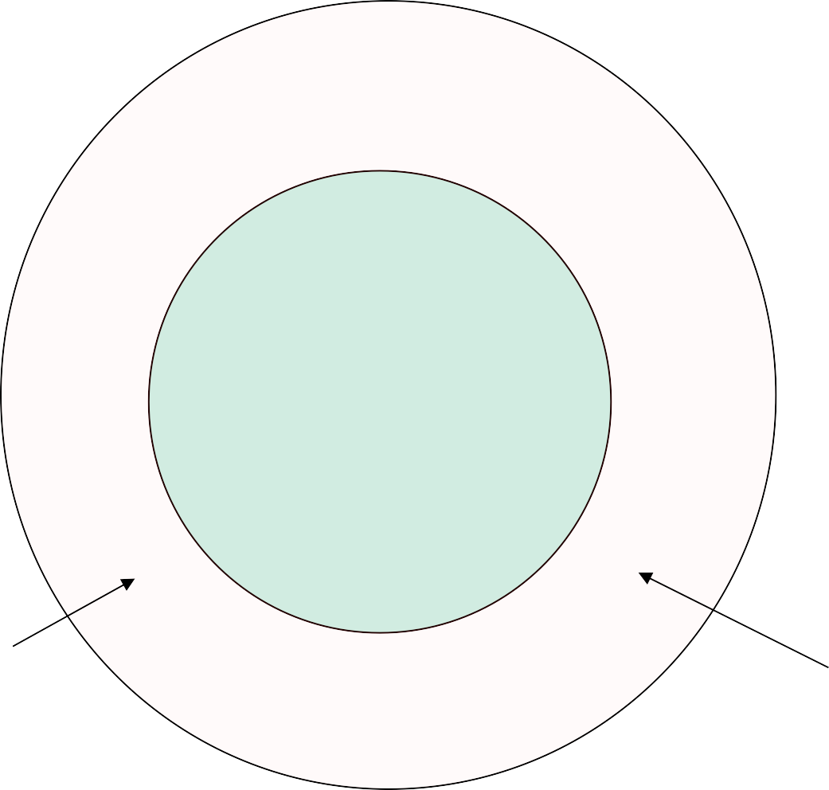

Decision Problems(CO5)
Not recursively enumerable languages
??
Decidable problems = Recursive languages
Recursively enumerable languages
Are there any languages
here?

Slide 90
Closure Properties of Recursive and RE Languages(CO5)
Next topic is Decidability
Review Lab notes on Math review – diagonalization etc.
First let’s look at closure properties of these classes of languages
Both closed under union, concatenation, star, reversal, intersection, inverse homomorphism.
Recursive closed under difference, complementation.
RE closed under homomorphism.

Slide 91
Proving Closure Properties…methodology(CO5)
Observe: To prove the closure properties we have to construct a Turing machine, i.e., an algorithm (!!!), to accept the language
Construction shown using a flowchart & combining other ”algorithms”
- Getting more and more like programming!
To prove a language L (constructed from other recursive languages) is recursive, provide an algorithm described by a ‘flowchart’ below
To show it is RE, the machine halts only if w is in the language
w
Yes No
M’
w ϵ L

Slide 92
Closure under Union(CO5)
Let L₁ = L(M₁) and L₂ = L(M₂).
Assume M₁ and M₂ are single-semi-infinite-tape TM’s.
Construct 2-tape TM M to copy its input onto the second tape and simulate the two TM’s M₁ and M₂ each on one of the two tapes, “in parallel.”
Recursive languages: If M₁ and M₂ are both algorithms, then M will always halt in both simulations.
RE languages: accept if either accepts, but you may find both TM’s run forever without halting or accepting.
92

Slide 93
for Recursive Sets
Algorithm/Picture of Union(CO5)
M must halt on all inputs:
accepts if w is in either, rejects if w not in either
M₁
Accept
Reject
OR Accept
Input w
M
Accept Reject
M₂
AND
Reject
Remember = “halt without accepting
93

Slide 94
Picture of Union of RE Sets(CO5)
M must halt and accept if w is in either language, else it may reject and halt or may not halt
Accept
OR
M
Accept
M₁
Accept
Input w
M₂
94

Slide 95
Closure under other set operations(CO5)
Recursive Languages are closed under
Union, Intersection, Concatenation, Star Closure
Complementation. Set difference
Reversal
Inverse Homomorphism
Recursively Enumerable (RE) languages are closed under
Union, Intersection, Concatenation, Star Closure
Reversal
Homomorphism
Inverse Homomorphism

Slide 96
Intersection of Recursive Sets – Same Idea(CO5)
M₁
Accept
Reject
AND Accept
Input w
M
M₂
Accept
Reject
OR
Reject
13

Slide 97
Intersection of RE Sets(CO5)
Accept
AND
M
Accept
M₁
Accept
Input w
M₂
Observe: if w is in the intersection then both machines will accept and halt on w =>
This machine M will halt and accept w
14
5/1/2024

Slide 98
Complement of Recursive Languages(CO5)
w
M
w ϵ L(M)
Yes No
No Yes
M’
5/1/2024

Slide 99
Star Closure(CO5)
Same ideas work for each case.
RE: guess many breaks, accept if M₁ accepts each piece.
Recursive: systematically try all ways to break input into some number of pieces.
5/1/2024

Slide 100
Reversal(CO5)
Start by reversing the input.
Then simulate TM for L to accept w if and only w^{R} is in L.
Works for either Recursive or RE languages.
5/1/2024

Slide 101
Recursive Enumerable (CO5)
Topic Objective: To understand the Recursive Enumerable Language
Recap: Till now we have studied about Turing Machine, Universal Turing Machine, Linear Bounded Automata and Church Thesis.
Prerequisite: Basic review of model to perform different operations like addition, subtraction, multiplication.
.

Slide 102
Recursive Enumerable (CO5)
Objective: To understand the Recursive Enumerable Language.
RE languages or type-0 languages are generated by type-0 grammars.
An RE language can be accepted or recognized by Turing machine which means it will enter into final state for the strings of language and may or may not enter into rejecting state for the strings which are not part of the language.
It means TM can loop forever for the strings which are not a part of the language.
RE languages are also called as Turing recognizable languages.
Link: https://www.youtube.com/watch?v=KJD_F-QGLmo

Slide 103
Halting Problem (CO5)
Topic Objective: To understand the Halting Problem in theory of computations.
Recap: Till now we have studied about Turing Machine, Universal Turing Machine, Linear Bounded Automata, Church Thesis and Recursive Enumerable Language.
Prerequisite: Basic review of model to perform different operations like addition, subtraction, multiplication.

Slide 104
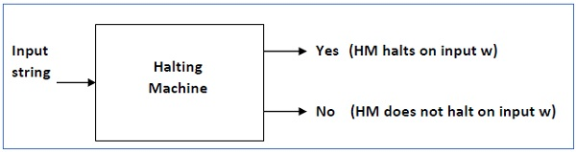
Halting Problem (CO5)
Objective: To understand the Halting Problem in theory of computations.
Input − A Turing machine and an input string w.
Problem − Does the Turing machine finish computing of the string w in a finite number of steps? The answer must be either yes or no.
Link for Further Explanation:
https://www.youtube.com/watch?v=mx1mnyagfdM&list=PL4B084328ED81F3AF

Slide 105
Halting Problem (CO5)
Objective: To understand the Halting Problem in theory of computations.
Input − A Turing machine and an input string w.
Problem − Does the Turing machine finish computing of the string w in a finite number of steps? The answer must be either yes or no.
Link for Further Explanation:
https://www.youtube.com/watch?v=mx1mnyagfdM&list=PL4B084328ED81F3AF

Slide 106
Undecidable Problems (CO5)
Objective: To understand the Undecidable Problems in theory of computations.
Undecidable Problems
A problem is undecidable if there is no Turing machine which will always halt in finite amount of time to give answer as ‘yes’ or ‘no’. An undecidable problem has no algorithm to determine the answer for a given input.
Examples
Ambiguity of context-free languages: Given a context-free language, there is no Turing machine which will always halt in finite amount of time and give answer whether language is ambiguous or not.
Equivalence of two context-free languages: Given two context-free languages, there is no Turing machine which will always halt in finite amount of time and give answer whether two context free languages are equal or not.
Everything or completeness of CFG: Given a CFG and input alphabet, whether CFG will generate all possible strings of input alphabet (∑*)is undecidable.
Regularity of CFL, CSL, REC and REC: Given a CFL, CSL, REC or REC, determining whether this language is regular is undecidable.

Slide 107
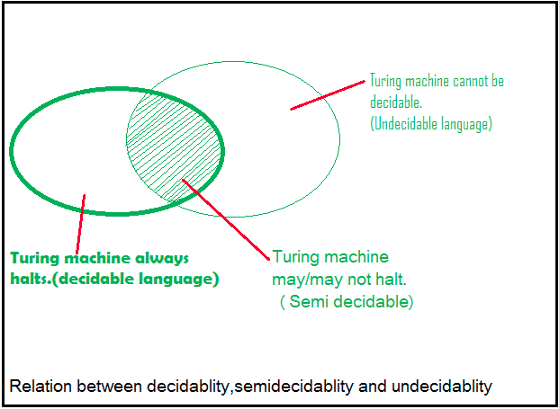
Undecidable Problems(CO5)
Two popular undecidable problems are halting problem of TM and PCP (Post Correspondence Problem). Semi-decidable Problems
A semi-decidable problem is subset of undecidable problems for which Turing machine will always halt in finite amount of time for answer as ‘yes’ and may or may not halt for answer as ‘no’.
Relationship between semi-decidable and decidable problem has been shown in Figure 1 as:

Slide 108
Undecidable Problems(CO5)
Rice’s Theorem
Every non-trivial (answer is not known) problem on Recursive Enumerable languages is undecidable.e.g.; If a language is Recursive Enumerable, its complement will be recursive enumerable or not is undecidable.
Reducibility and Undecidability
Language A is reducible to language B (represented as A≤B) if there exists a function f which will convert strings in A to strings in B as:
w ɛ A <=> f(w) ɛ B
Theorem 1: If A≤B and B is decidable then A is also decidable.
Theorem 2: If A≤B and A is undecidable then B is also undecidable.

Slide 109
Undecidable Problems(CO5)
Theorem 1: If A≤B and B is decidable then A is also decidable.
Theorem 2: If A≤B and A is undecidable then B is also undecidable.
Question: Which of the following is/are undecidable?
G is a CFG. Is L(G)=ɸ?
G is a CFG. Is L(G)=∑*?
M is a Turing machine. Is L(M) regular?
A is a DFA and N is an NFA. Is L(A)=L(N)?
A. 3 only
B. 3 and 4 only
C. 1, 2 and 3 only
D. 2 and 3 only

Slide 110
Undecidable Problems(CO5)
Explanation:
Option 1 is whether a CFG is empty or not, this problem is decidable.
Option 2 is whether a CFG will generate all possible strings (everything or completeness of CFG), this problem is undecidable.
Option 3 is whether language generated by TM is regular is undecidable.
Option 4 is whether language generated by DFA and NFA are same is decidable. So option D is correct.
Question: Which of the following problems are decidable?

Slide 111
Undecidable Problems(CO5)
Does a given program ever produce an output?
If L is context free language then L’ is also context free?
If L is regular language then L’ is also regular?
If L is recursive language then L’ is also recursive?
A. 1,2,3,4
B. 1,2
C. 2,3,4
D. 3,4

Slide 112
Undecidable Problems(CO5)
Explanation:
As regular and recursive languages are closed under complementation, option 3 and 4 are decidable problems.
Context free languages are not closed under complementation, option 2 is undecidable.
Option 1 is also undecidable as there is no TM to determine whether a given program will produce an output. So, option D is correct.
Question: Consider three decision problems P1, P2 and P3. It is known that P1 is decidable and P2 is undecidable. Which one of the following is TRUE?
A. P3 is undecidable if P2 is reducible to P3
B. P3 is decidable if P3 is reducible to P2’s complement
C. P3 is undecidable if P3 is reducible to P2
D. P3 is decidable if P1 is reducible to P3

Slide 113
Undecidable Problems(CO5)
Explanation:
Option A says P2≤P3. According to theorem 2 discussed, if P2 is undecidable then P3 is undecidable. It is given that P2 is undecidable, so P3 will also be undecidable. So option (A) is correct.
Option C says P3≤P2. According to theorem 2 discussed, if P3 is undecidable then P2 is undecidable. But it is not given in question about undecidability of P3. So option (C) is not correct.
Option D says P1≤P3. According to theorem 1 discussed, if P3 is decidable then P1 is also decidable. But it is not given in question about decidability of P3. So option (D) is not correct.
Option (B) says P3≤P2’. According to theorem 2 discussed, if P3 is undecidable then P2’ is undecidable. But it is not given in question about undecidability of P3. So option (B) is not correct.

Slide 114
Post Correspondence Problem (CO5)
Topic Objective: To understand the importance of post correspondence problem.
Recap: Till now we have studied about Turing Machine, Universal Turing Machine, Linear Bounded Automata, Church Thesis, Recursive Enumerable Language and Halting Problem.
Prerequisite: Basic review of model to perform different operations like addition, subtraction, multiplication.

Slide 115
Post Correspondence Problem (CO5)
Objective: To understand the importance of post correspondence problem.
The Post Correspondence Problem (PCP), introduced by Emil Post in 1946, is an undecidable decision problem. The PCP problem over an alphabet ∑ is stated as follows −
Given the following two lists, M and N of non-empty strings over ∑
M = (x₁, x₂, x₃,………, x_{n})
N = (y₁, y₂, y₃,………, y_{n})
We can say that there is a Post Correspondence Solution, if for some i₁,i₂,………… i_{k}, where 1 ≤ i_{j} ≤ n, the condition x_{i1} …….x_{ik} = y_{i1} …….y_{ik} satisfies.
Link for further explanation :
https://www.youtube.com/watch?v=YSr5zmVqZLI

Slide 116
Post Correspondence Problem(CO5)
Problem:
Find whether the lists M = (abb, aa, aaa) and N = (bba, aaa, aa)
have a Post Correspondence Solution?
Solution:
Here,
x₂x₁x₃ = ‘aaabbaaa’
and y₂y₁y₃ = ‘aaabbaaa’
We can see that
x₂x₁x₃ = y₂y₁y₃
Hence, the solution is i = 2, j = 1, and k = 3.
 | x₁ | x₂ | x₃
M | Abb | aa | aaa
N | Bba | aaa | aa

Slide 117
Faculty Video Links, Youtube & NPTEL Video Links and Online Courses Details
Youtube/other Video Links
https://www.youtube.com/watch?v=IhyEGNn-7Uo
https://www.youtube.com/watch?v=BR6fHjKFqa0
https://www.youtube.com/watch?v=vhSMp91tS6k
https://www.youtube.com/watch?v=mPec64RUCsk
https://www.youtube.com/watch?v=moPtwq_cVH8

Slide 118
Daily Quiz
Design a TM to compute the function f(n)=n²
Define Post Correspondence Problem and Modified Post Correspondence Problem.
Design a TM to accept the language “The set of strings with an equal number of 0’s and 1’s”.
Design a right shift TM over an alphabet{0,1}
Write short note on Halting Problem.
Define Basic model of Turing Machine.
Explain the techniques for Turing Machine construction.
Explain Church’s Thesis.
Write short note on Universal Turing Machine.
When a language is said to be recursive or recursively enumerable.

Slide 119
Weekly Assignment
1.Define Turning Machine?Explain Turning thesis briefly.
2.Explain how turing machine can be used as generating device?
3.Construct turing machine for accepting L- L={a^{n}b^{n}|n>=0}
4.Explain Types of turing machine and universal turing machine.
5.Design a turing machine to recognize all strings consisting of even number of 1’s.
6.Explain Recursively Enumerable languages.
7.Explain the post correspondence problem.
8.Construct a Turing machine with tape symbols 0, 1, and B that, given a bit string as input, replaces all 0’s on the tape with 1’s and does not change any of the 1’s on the tape m.
9.Show that Recursively enumerable languages are closed under complement.
10.Show that Recursively languages are closed under union.

Slide 120
MCQs
1. Find the odd one :
Multiple track
Subroutines
Recursion
Shifting over
2. Which operation is not a part of TM?
Enter Accepting State
Enter Non Accepting state
Enter infinite loop and never halts
None of the above

Slide 121
MCQs (Continued)
3. Which of the statement is not true for TM?
Computers of functions on non negative numbers
Language Recognition
Generating devices
None
4. A finite control of TM is used in order to hold a finite amount of data. Say True or False:
TRUE
FALSE
May Be
Cant Say

Slide 122
MCQs (Continued)
5. Find the odd one :
Multiple track
Subroutines
Recursion
Shifting over
6. Which operation is not a part of TM?
Enter Accepting State
Enter Non Accepting state
Enter infinite loop and never halts
None of the above

Slide 123
MCQs (Continued)
7. Which of the statement is not true for TM?
Computers of functions on non negative numbers
Language Recognition
Generating devices
None
8. X is a simple mathematical model of a computer. X has unrestricted and unlimited memory. X is a FA with R/W head. X can have an infinite tape divided into cells, each cell holding one symbol. Name X?
NDFA
PDA
TM
None of the above

Slide 124
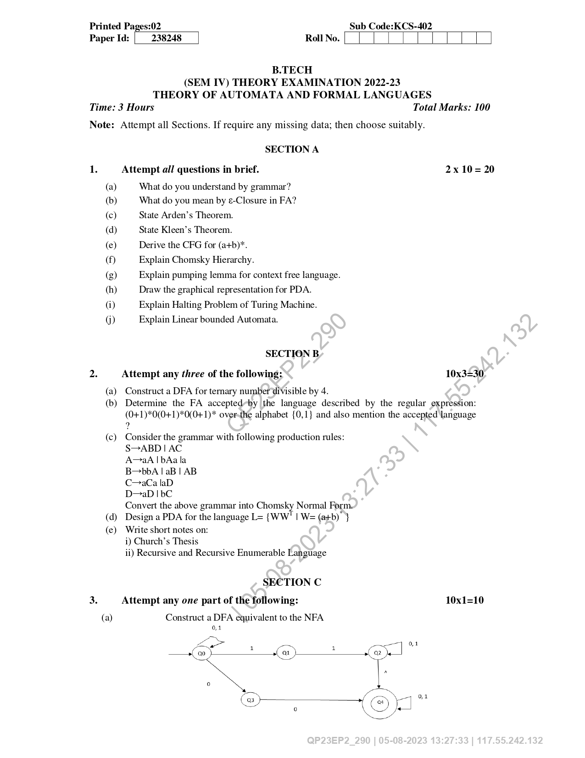
Old University Exam Paper

Slide 125
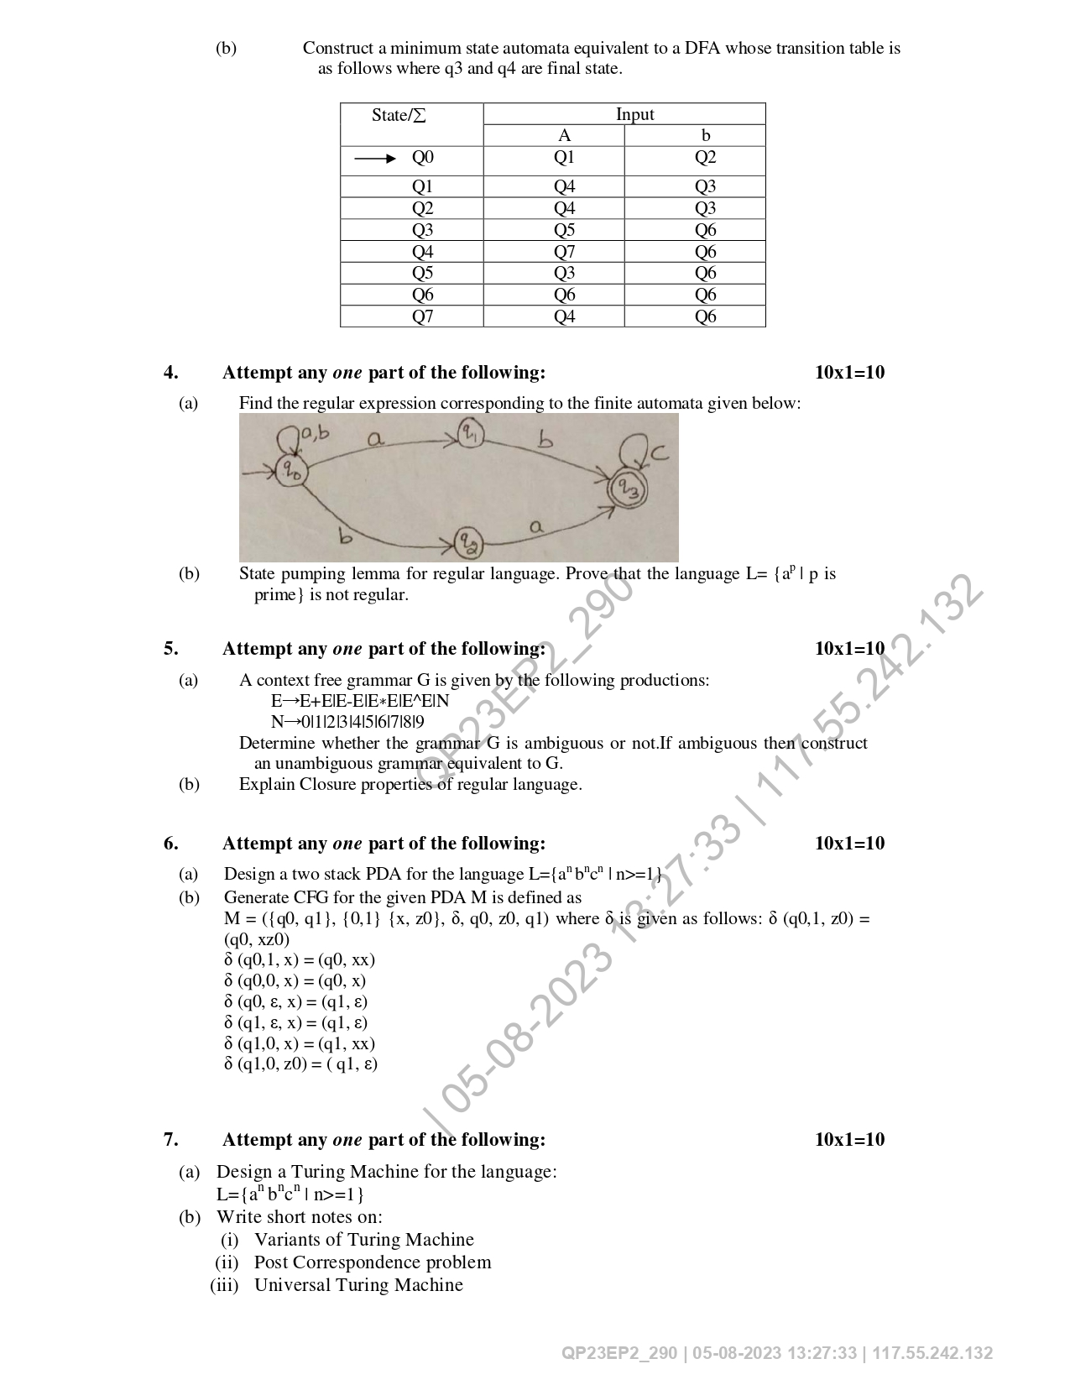
Old University Exam Paper (Continued)

Slide 126
Expected Questions for University Exam
Design a TM to reverse a string over an alphabet {0,1}.
Design a TM to check whether a string over {a,b}contains equal number of a’s and b’s.
Design a TM that replace every occurrence of abb by baa.
Design a TM for addition of Unary numbers.
Design a TM for subtraction of a Unary numbers.

Slide 127
Summary
Turing machines use an infinite tape divided into a number of rectangular cells and a tape head that can read and write symbols and can move in both the directions left and right.
The input for a transition function of a TM are current state and current tape symbol.
The output of the transition function are the state in which TM has to be after reading the current tape symbol.

Slide 128
References
Aho, Hopcroft and Ullman, The Design and Analysis of Computer Algorithms, Addison Wesley.
Aho, Sethi, Ullman, Compilers Principles, Techniques and Tools, Pearson Education, 2003.
Hopcroft and Ullman, Introduction to Automata Theory, Languages and Computation, Addison Wesley.
Kohavi, ZVI, Switching And Finite Automata Theory, Tata McGraw-Hill, 2006.
Lewis and Papadimitriou, Elements of the Theory of Computation, Prentice-Hall.
Martin, Introduction to Languages and the Theory of Computation, McGraw-Hill, 2nd edition,1996.
Mishra, KLP, Chandrasekaran, N. Theory of Computer Science, (Automata, Languages and Computation) PHI, 2002.

Slide 129
Noida Institute of Engineering and Technology, Greater Noida
Thank You

